Slide 1

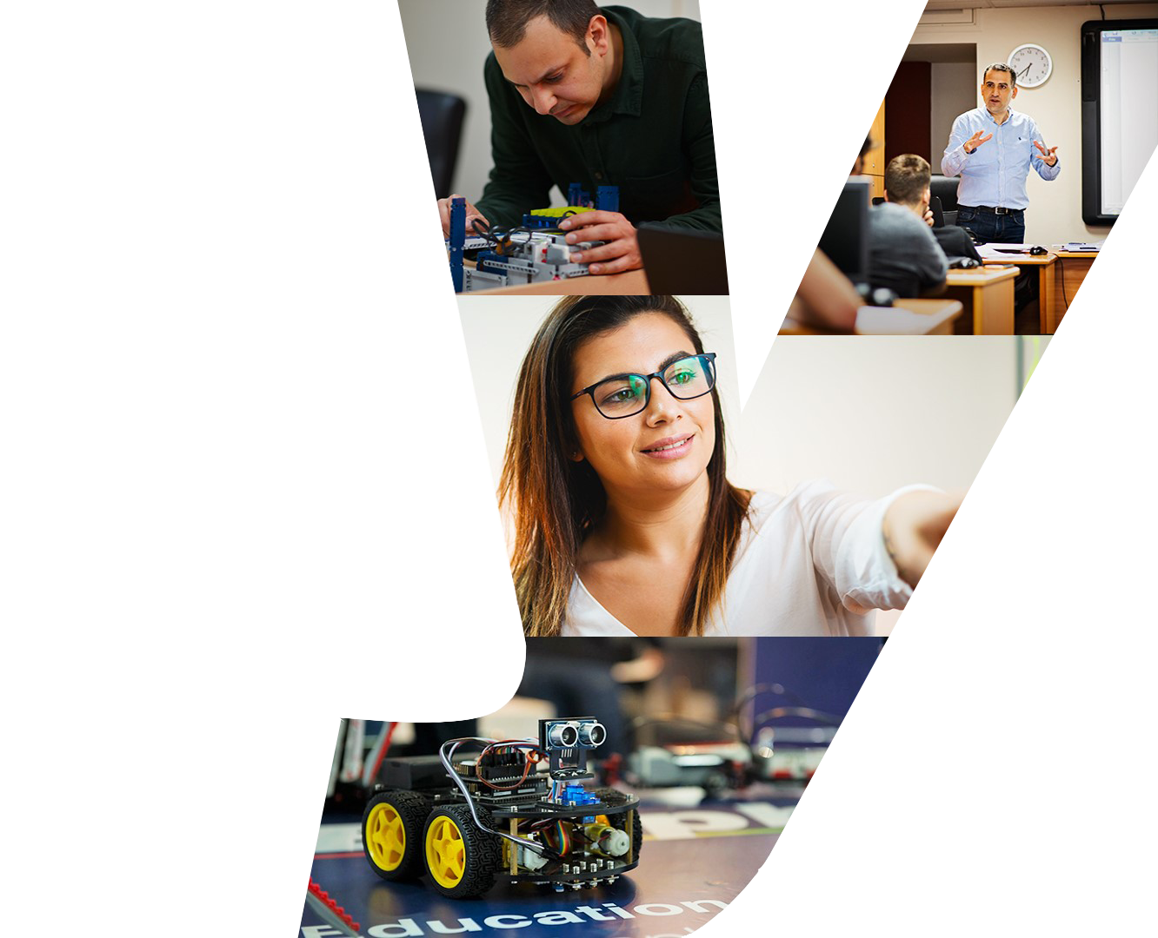

Work Placement Projects
______
23rd – 27th of October 2023

Slide 2

Project 1:
Archeological Museum
______
Team 1 – Malthe, Oliver & Benjamin

Slide 3
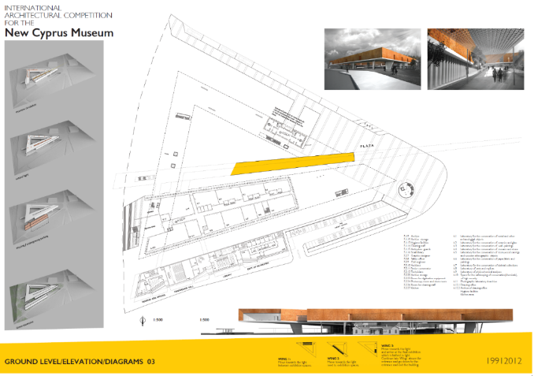
Recreating the Cyprus History Museum in VR
Objective: Recreate an architectural replica of the Cyprus History Museum in a VR environment.
Description/Guidelines:
Research and Materials Collection:
Obtain detailed architectural plans, photographs, and other relevant materials of the Cyprus History Museum.
Familiarize yourself with the historical, cultural, and architectural significance of the building.
VR Design Principles:
Ensure that the scale is true-to-life, so users feel like they're in the real space.
Consider user experience: incorporate intuitive navigation controls and user-friendly interactions.
Make sure the VR environment is comfortable, avoiding designs that might induce motion sickness or discomfort.
3D Modeling:
Begin with a basic block-out of the structure to get the size and space correct.
Refine the model by adding detailed features like windows, doors, artifacts, and exhibitions if applicable.
Optimize models to ensure smooth performance in VR.
Texturing and Lighting:
Apply accurate and high-quality textures to give the model a realistic appearance.
Consider natural light sources and the way they interact with the building.
Make sure all spaces are well-lit, ensuring a clear and comfortable viewing experience for users.
Interactivity:
Allow users to move freely through the museum.
Incorporate interactive elements, such as information plaques, audio guides, or clickable exhibits that offer more information.
Provide a navigation map or guide, allowing users to teleport to specific sections or rooms if desired.
Audio Integration:
Incorporate ambient sounds that match the museum's environment, like echoes, footsteps, or subtle background music.
If using audio guides or clickable exhibits, ensure the sound quality is clear and at a comfortable volume level for users.
Testing:
Frequently test your VR environment with different users to gather feedback.
Make necessary adjustments based on user experience and feedback.
Presentation Preparation:
Develop a brief presentation discussing your design process, challenges faced, and the solutions you implemented.
Practice navigating through the VR museum to showcase its features effectively.

Slide 4
Recreating the Cyprus History Museum in VR
Timeline:
Day 1: Research, materials collection, and initial block-out of the structure. Day 2: Refinement of 3D model and beginning of texturing. Day 3: Finalize texturing and start on lighting and interactivity. Day 4: Audio integration and further testing of the VR environment. Day 5: Final testing, adjustments, and presentation preparation.
Deliverables:
A working VR replica of the Cyprus History Museum.
A brief presentation showcasing the project and discussing the design process.
Tips:
Collaborate and communicate with peers, exchanging ideas and solutions.
Prioritize key areas or features if time is limited.
Keep user comfort and experience as the top priority when making design decisions.

Slide 5
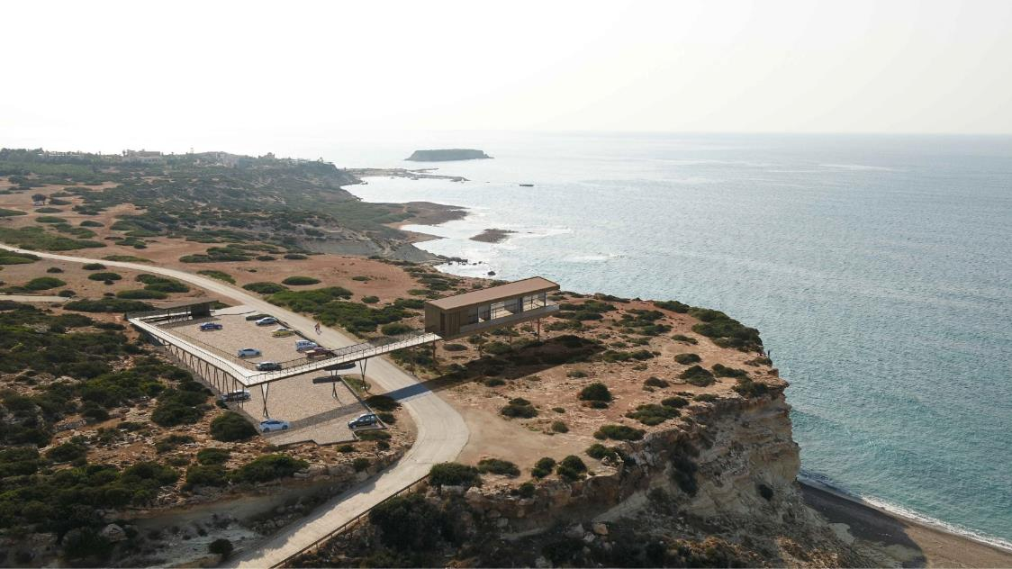
Project 2:
Akamas National Park Observatory
______
Team 2 – Markus, Gabriel and Zhentao

Slide 6
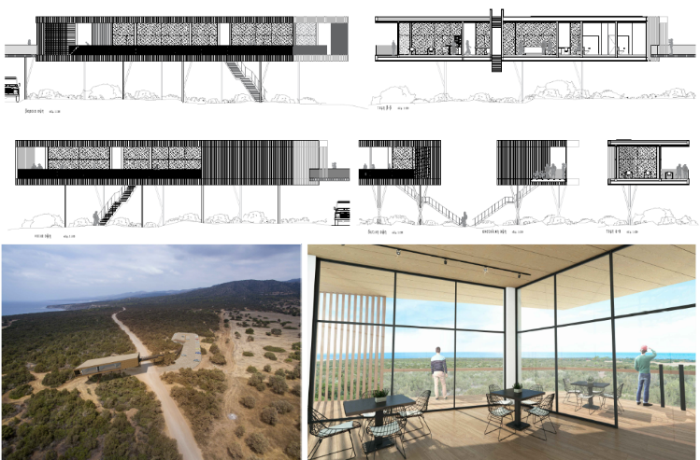
Recreating the Akamas Natural Park Observatory in VR
Objective: Recreate an immersive replica of the Akamas Natural Park Observatory in a VR environment, capturing the essence of its architecture and the natural beauty of its surroundings, including the sea and the terrain.
Description/Guidelines:
Research and Materials Collection:
Obtain architectural plans, photographs, and other relevant materials of the Akamas Natural Park Observatory.
Understand the ecological and geographical significance of Akamas and its landmarks.
VR Design Principles:
Ensure that the environment's scale is true-to-life.
Prioritize user experience: intuitive navigation controls and user-friendly interactions.
Design with comfort in mind, avoiding motion sickness-inducing elements.
3D Modeling:
Start with a block-out of the observatory and its immediate surroundings.
Extend the model to include the sea, ground, and other landscape features.
Optimize the environment for smooth VR performance.
Texturing and Lighting:
Apply realistic textures, capturing the unique look of the Akamas terrain, vegetation, and the observatory.
Emulate the Mediterranean lighting atmosphere, considering both daytime and potential nighttime views.
Interactivity:
Allow users to explore freely, not just within the observatory but also the surrounding park.
Introduce interactive elements like information points, highlighting flora, fauna, and geological features.
Audio Integration:
Use ambient nature sounds – the rustling of leaves, chirping of birds, waves crashing, etc.
Consider audio guides detailing the significance of certain spots or natural features.
Testing:
Test the environment with varied users to receive diverse feedback.
Adjust based on user experience and suggestions.
Presentation Preparation:
Prepare a presentation detailing your design process, challenges, and the solutions applied.
Plan a walkthrough of the VR environment to highlight its features.

Slide 7
Timeline:
Day 1: Research, materials collection, and initial block-out. Day 2: Main 3D modeling of the observatory and significant landscape features. Day 3: Texturing and beginning of lighting; initiate interactivity elements. Day 4: Complete lighting, audio integration, and extend interactivity; conduct preliminary testing. Day 5: Final refinements, thorough testing, and presentation prep.
Deliverables:
A working VR replica of the Akamas Natural Park Observatory and its landscape.
A presentation explaining the design decisions and the development process.
Tips:
Collaboration is key. Divide tasks based on strengths, especially since landscape modeling can be detailed work.
Prioritize iconic or significant areas of Akamas for better realism in limited time.
Continually step into the user's shoes, ensuring an organic and natural-feeling VR experience.
.

Slide 8
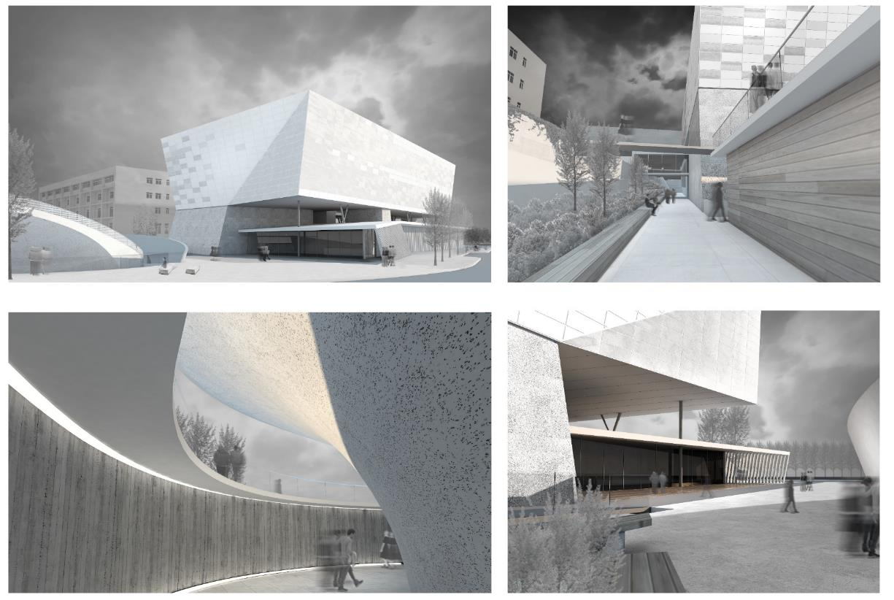
Project 3:
The Cyprus Institute of Neurology & Genetics
______
Team 3 – Karam, Boris, Johan and Bertram

Slide 9
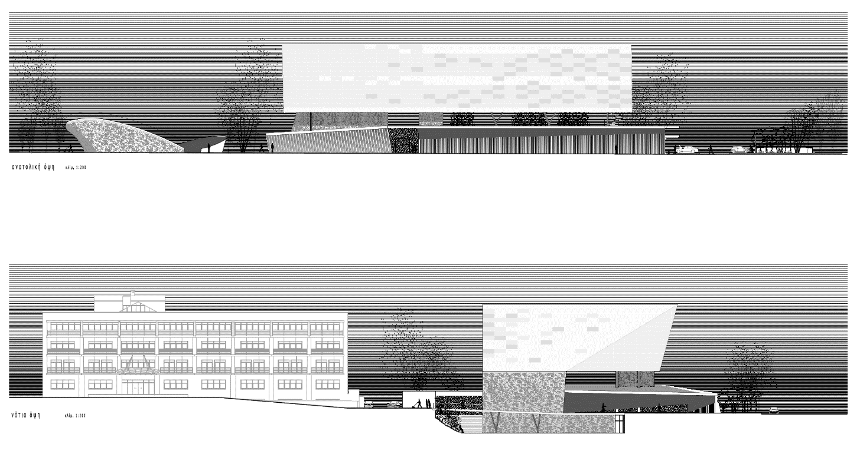
Recreating the Institute of Neurology and Genetics in VR
Objective: Develop an immersive VR representation of the Institute of Neurology and Genetics. This project should not only depict the architectural essence of the institution but also give a hint of its scientific significance.
Description/Guidelines:
Research and Materials Collection:
Obtain architectural plans, photographs, and other pertinent materials about the Institute of Neurology and Genetics.
Understand the institution's role, its major departments, labs, and its scientific contributions.
VR Design Principles:
Ensure a true-to-life scale for authenticity.
Prioritize user comfort and experience with intuitive navigation and interactions.
Strive for a seamless VR experience, avoiding designs that might induce discomfort.
3D Modeling:
Begin with a basic block-out of the institute's structure.
Gradually introduce intricate features such as labs, equipment, and common spaces.
Ensure models are optimized for fluid VR performance.
Texturing and Lighting:
Use textures that bring out the modern, sterile, and scientific vibe of the institute.
Pay attention to lighting, considering the difference between public spaces and specialized labs.
Interactivity:
Allow users to traverse the institute freely.
Integrate interactive points that delve into the science – perhaps 3D models of DNA strands, neurons, or short audio-visual presentations on genetics and neurology.
Implement a navigation guide or map for easy teleportation to various departments or sections.
Audio Integration:
Embed ambient sounds appropriate for a scientific institute, such as muted conversations, equipment hums, etc.
Consider informative audio snippets or virtual guided tours explaining various sections and their significance.
Testing:
Regularly test your VR representation with a diverse set of users for feedback.
Iterate based on the user experience and constructive criticism.
Presentation Preparation:
Design a presentation discussing your approach, obstacles faced, and solutions employed.
Plan a guided VR tour to efficiently exhibit its features during the showcase.

Slide 10
Timeline:
Day 1: Research and collection of materials; start block-out of the structure. Day 2: Detailed 3D modeling, focusing on the building's key features. Day 3: Texturing and lighting initiation; start on interactivity points. Day 4: Integrate audio and finalize interactivity; begin user testing. Day 5: Address feedback, finalize the VR model, and prepare for the presentation.
Deliverables:
A functional VR replica of the Institute of Neurology and Genetics.
A presentation detailing the design process and highlighting key VR features.
Tips:
Working with a scientific institute means precision matters. Make sure the representation is accurate, especially in lab spaces.
Collaborate with peers, divide tasks efficiently, and maintain open communication.
Think about how to make the scientific aspect engaging for users – use interactivity to explain complex topics simply.

Slide 11
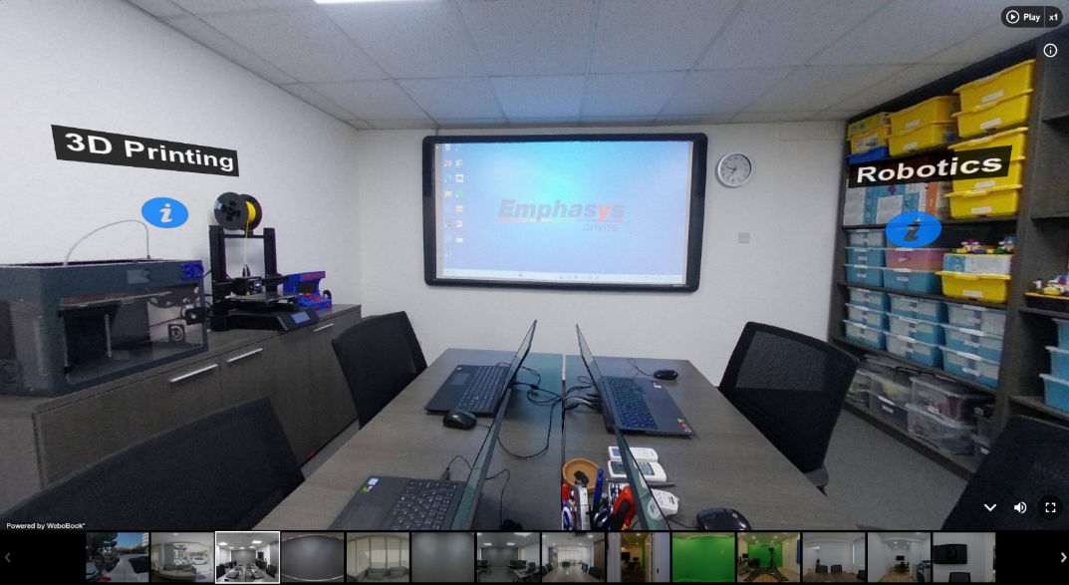
Project 4:
Mapping Emphasys Centre
______
Team 4 - Sebastian, Gustav and William

Slide 12
Virtual Tour of Emphasys Centre with Augmented Virtual Elements
Objective: To create a comprehensive virtual tour of the Emphasys Centre using 360-degree imagery, complemented by virtual augmentations that provide detailed explanations of equipment and highlight projects from each department.
Description/Guidelines:
Research and Pre-planning:
Tour the Emphasys Centre to understand its layout, departments, and significant areas.
Make a list of key spots where 360-degree photos will be taken, ensuring comprehensive coverage.
360 Camera Techniques:
Ensure clarity and stability when capturing images. Using a tripod can be beneficial.
Be mindful of lighting conditions to ensure high-quality images.
Virtual Augmentations:
After capturing a location, note down significant equipment or project areas.
Design virtual markers or icons that users can click or hover over during the tour.
Content Creation for Augmentations:
Develop concise, engaging content explaining the equipment or projects. This can be in text, audio, or video formats.
Ensure the content is accessible, understandable, and adds value to the tour.
Virtual Tour Integration:
Stitch the 360-degree photos together using the Unity Game engine to create a continuous flow.
Integrate the virtual augmentation markers at appropriate locations.
Interactivity and Navigation:
Allow users to navigate smoothly between different areas of the Emphasys Centre.
Ensure the interactive elements (explanations of equipment, project details) are intuitive and easy to access.
Testing and Refinement:
Test the virtual tour on different devices to ensure compatibility.
Gather feedback on the user experience, content clarity, and any potential glitches.
Refine and iterate based on feedback.
Presentation Preparation:
Create a brief overview of the project's objective, the techniques used, and the challenges faced.
Showcase the virtual tour, highlighting its features and interactive elements.

Slide 13
Timeline:
Day 1: Research, pre-planning, and initial tour of Emphasys Centre. Day 2: Capture 360-degree photos of the designated spots within the centre. Day 3: Begin integration of images and design of virtual augmentations. Day 4: Content creation for augmentations and integration into the tour. Day 5: Testing, refinement, and preparation for the final presentation.
Deliverables:
A fully functional virtual tour of the Emphasys Centre with integrated virtual augmentations.
A presentation detailing the development process and showcasing the tour.
Tips:
Collaboration is key. While one person focuses on capturing images, another can focus on noting significant points for augmentation.
The user experience should be at the forefront. Ensure that the tour is not just informative but also engaging.
Given the limited time, prioritize key areas and significant projects to highlight.

Slide 14


Thank you.
T. +357 22 663010
E. info@emphasyscentre.com
_____________________________
/emphasyscentre
www.emphasyscentre.com

